Slide 1

L02: jQuery Introduction
C273 – Advanced Web Application Development in PHP

Slide 2
HTML DOM
DOM stands for Document Object Model.
Defines a standard set of objects for HTML, and a standard way to access and manipulate HTML documents
All HTML elements, along with their containing text and attributes, can be accessed through the DOM.
The contents can be modified or deleted, and new elements can be created.

Slide 3
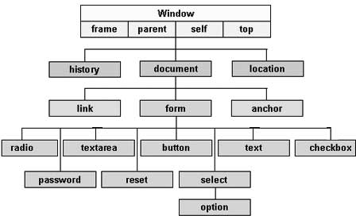
DOM Hierarchy
The objects are organized in a hierarchy. This hierarchical structure applies to the organization of objects in a Web document.

Slide 4
jQuery – What is it?
jQuery is a lightweight, "write less, do more", JavaScript library.
The purpose of jQuery is to make it much easier to use JavaScript on your website.
jQuery takes a lot of common tasks that require many lines of JavaScript code to accomplish, and wraps them into methods that you can call with a single line of code.
jQuery also simplifies a lot of the complicated things from JavaScript, like AJAX calls and DOM manipulation.

Slide 5






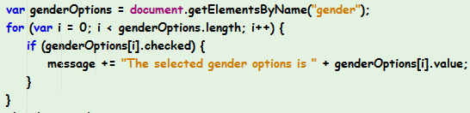






Why use jQuery?
jQuery can simplify JavaScript development

Slide 6
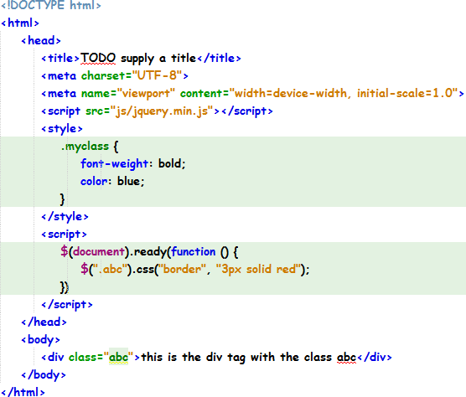
Embedding jQuery
Download the library from jquery.com
Embed it into your HTML page
CSS Code
JavaScript/jQuery Code
HTML Code

Slide 7
Embedding jQuery
Or just include the url to a CDN (Content Delivery Network) into your HTML page:
<script src="https://ajax.googleapis.com/ajax/libs/jquery/3.4.1/jquery.min.js"></script>

Slide 8
Locally hosted jQuery vs CDN
Locally hosted | CDN
Pro: Create jQuery apps with no connection to internet Pro: Cater for users with network bandwidth limitations Con: Maintain jQuery files within your app | Pro: Distributed network uses servers closest to the website visitor to deliver the jQuery library. Pro: Faster site loading. Once the library from a CDN is cached by the browser, it doesn’t have to be downloaded again. For example Google CDN is used by many people Con: rely on a third party to be available

Slide 9
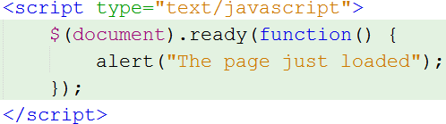
$(document).ready(function() { });
The "$" symbol or the word jQuery = jQuery function (contains all jQuery functionalities).
document refers to a selector. It selects the document / webpage.
The "ready" event indicates that the webpage Document Object Model (DOM) is ready for JavaScript code to execute.
The function part indicates the function which will be called when the above is true. This function contains an alert command

Slide 10
jQuery syntax
Basic syntax is: $(selector).method()
A $ sign to define/access jQuery
A (selector) to "query (or find)" HTML elements
A jQuery method() to be performed on the element(s)

Slide 11
RECAP on CSS
Class
.center {text-align:center;}
Id
#para1 { text-align:center; color:red;}
Internal, inline, and external
<head> <style type="text/css"> p { text-align:center; } </style>
</head> | Internal
<head> html <link rel="stylesheet" type="text/css" file href="mystyle.css" /> </head>
hr {color:sienna;}
p {margin-left:20px;} |  | External
body {background-image: url("images/back40.gif");} | css stylesheet: mystyle.css
<p style="background: blue; color: white;">A new background and font color with inline CSS</p>
Inline

Slide 12
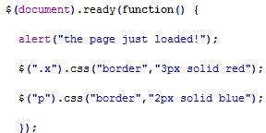
Selectors
Retrieve content from the HTML document and manipulate them using other functions
$("p");
Get all <p> tags
$("#list1");
Get the tags with id “list1”
$("li.ab");
Get all <li> tags with class ab
alert function
Get all tags with class x and modify the border property to 3 pixels, solid, and red
Get all <p> tags and modify the border property to 2 pixels, solid, and blue

Slide 13
Basic Selectors
jQuery selectors allow you to select and manipulate HTML element(s).
All selectors in jQuery start with the dollar sign and parentheses: $().
Selector | Example | Selects
#id | $("#lastname") | The element with id="lastname"
.class | $(".intro") | All elements with class="intro"
.class,.class | $(".intro,.demo") | All elements with the class "intro" or "demo"
element | $("p") | All <p> elements
el1,el2,el3 | $("h1,div,p") | All <h1>, <div> and <p> elements

Slide 14
Exercise 1a (Basic Selectors)
HTML Elements | jQuery selectors
<h1 id="myHeader">What element I am!</h1> |  | $("h1"), $("h1#myHeader")
 | or $("#myHeader")
<div class="abc">this is the div tag with the class abc</div> | $("div.abc")
<div><span class="abc">this is sub one</span></div> | $("div .abc ")
<h1 id="myHeader">What element I am!</h1> <div class="abc">this is the div tag with the class abc</div> | $("#myHeader, div.abc")

Slide 15
Index-based Selectors
jQuery provides its own set of index-based selectors which use zero-based indexing.
This means that to select the third element you will have to use the index 2.
Selector | Example | Selects
:first | $("p:first") | The first <p> element
:last | $("p:last") | The last <p> element
:even | $("tr:even") | All even <tr> elements
:odd | $("tr:odd") | All odd <tr> elements
:eq(index) | $("ul li:eq(3)") | The fourth element in a list (index starts at 0)
:gt(no) | $("ul li:gt(3)") | List elements with an index greater than 3
:lt(no) | $("ul li:lt(3)") | List elements with an index less than 3

Slide 16
Exercise 1b (Index-based Selectors)
HTML Elements
jQuery selectors
<div class="green">Green Triangle</div>
$(".green:first")
<li>Fourth Item</li>
$("li:last") or $("ul li:last")
<li>Second Item</li>
<li>Fourth Item</li>
$("ul li:odd") or
$(“ul li:eq(1), ul li:eq(3)”)
<div class="red">Red Triangle</div>
<div class="green">Green Triangle</div>
<div class="purple">Purple Square</div>
$("div:even")
<li>Second Item</li>
$("li:eq(1)")
$("div:gt(2)")
<div class="green">Green Square</div>
<div class="purple">Purple Square</div>
<div class="red">Red Triangle</div>
<div class="blue">Blue Triangle</div>
$("div:lt(2)")

Slide 17
Attribute Selectors
You can also select elements based on the value of their attributes.
Selector | Example | Selects
[attribute] | $("[href]") | All elements with a href attribute
[attribute=value] | $("[href='default.htm']") | All elements with a href attribute value equal to "default.htm"
[attribute!=value] | $("[href!='default.htm']" ) | All elements with a href attribute value not equal to "default.htm"
[attribute$=value] | $("[href$='.jpg']") | All elements with a href attribute value ending with ".jpg"
[attribute^=value] | $("[title^='Tom']") | All elements with a title attribute value starting with "Tom"

Slide 18
Exercise 1d (Attribute Selectors)
HTML Elements | jQuery selectors
<div class="red triangle">Red Triangle</div> | $("[class='red triangle']")
<div class="red triangle">Red Triangle</div> <div class="red circle">Red Circle</div> | $("[class^='red']")
<div class="red triangle">Red Triangle</div> <div class="blue triangle">Blue Triangle</div> | $("[class$='triangle']")

Slide 19
Form Selectors
jQuery provides a shorter version of selectors for most of the input elements in a form.
 | Selector | Example | Selects
 | :input | $(":input") | All input elements
 | :text | $(":text") | All input elements with type="text"
 | :password | $(":password") | All input elements with type="password"
 | :radio | $(":radio") | All input elements with type="radio"
 | :checkbox | $(":checkbox") | All input elements with type="checkbox"
 | :submit | $(":submit") | All input elements with type="submit"
 | :reset | $(":reset") | All input elements with type="reset"
 | :button | $(":button") | All input elements with type="button"
 | :image | $(":image") | All input elements with type="image"
 | :file | $(":file") | All input elements with type="file"
 | :selected | $(":selected") | All selected input elements
 | :checked | $(":checked") | All checked input elements

Slide 20
Exercise 1d (Form Selectors)
<p>Customer Name:<input type="text" name="custName" value="John Smith"/>
<p>Phone:<input type="text" name="phone" value="12345678"/>
</p>
<p>Gender
<input type="radio" name="gender" value="M" checked/> Male
<input type="radio" name="gender" value="F" /> Female
</p>
<p>Hobbies
<input type="checkbox" name="hobbies" value="badminton" checked/> Badminton
<input type="checkbox" name="hobbies" value="swimming" checked/> Swimming
<input type="checkbox" name="hobbies" value="basketball" /> Basketball
</p>
<p><input type="submit"/>
HTML Elements | jQuery selectors
Customer Name and Phone |  | $(":text") or $("[type=text]")
Customer Name |  | $("[name=custName]")
Male and Female |  | $(":radio"), $("[type=radio]") or
 |  | $("[name=gender]")
Badminton and Swimming |  | $(":checkbox:checked"),
 |  | $("[name=hobbies]:checked") or
 |  | $("[type=checkbox]:checked")

Slide 21
jQuery HTML/CSS methods
Method | Description
addClass() | Adds one or more class names to selected elements
append() | Inserts content at the end of selected elements
css() | Sets or returns one or more style properties for selected elements
html() | Sets or returns the content of selected elements
prepend() | Inserts content at the beginning of selected elements
removeClass() | Removes one or more classes from selected elements
text() | Sets or returns the text content of selected elements
toggleClass() | Toggles between adding/removing one or more classes from selected elements
val() | Sets or returns the value attribute of the selected elements (for form elements)
http://www.w3schools.com/jquery/jquery_ref_html.asp

Slide 22
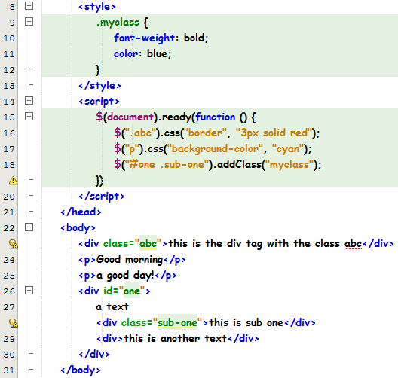
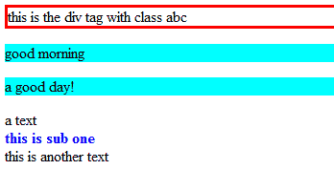
Exercise 2
HTML page with jQuery
HTML page displayed
on the browser

Slide 23
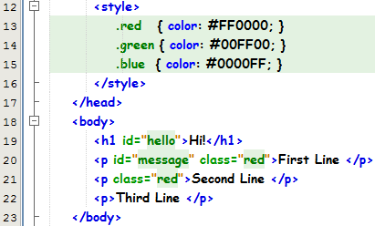
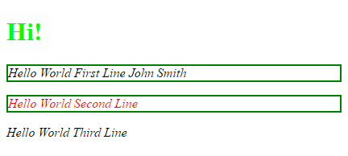

Exercise 2a
Open exercise2a.html

Slide 24




Exercise 2a - solution
The text “Hi!” in green colour
$('#hello').addClass('green');
All paragraphs in italic
$("p").css("font-style", "italic");
A 2px solid green border around the first and second line
$(".red").css("border", "2px solid green");
Change the colour of “First Line” from red to black (remove the class)
$("#message").removeClass("red");

Slide 25


Exercise 2a - solution
Append “John Smith” to “First Line”
$('#message').append(" John Smith");
Prepend “Hello World” to the first, second and third lines
$('p').prepend("Hello World ");

Slide 26
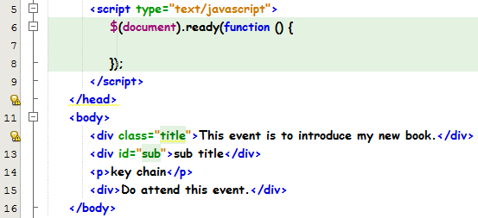
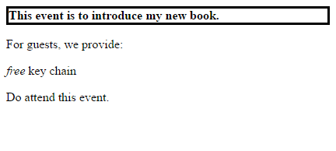

Exercise 2b
Open exercise2b.html

Slide 27

Exercise 2b - solution
$(".title").css("font-weight", "bold");
$(".title").css("border", "3px solid");
$("p").prepend(“<i>free</i> ");
$("#sub").html("For guests, <br/>we provide:");

Slide 28
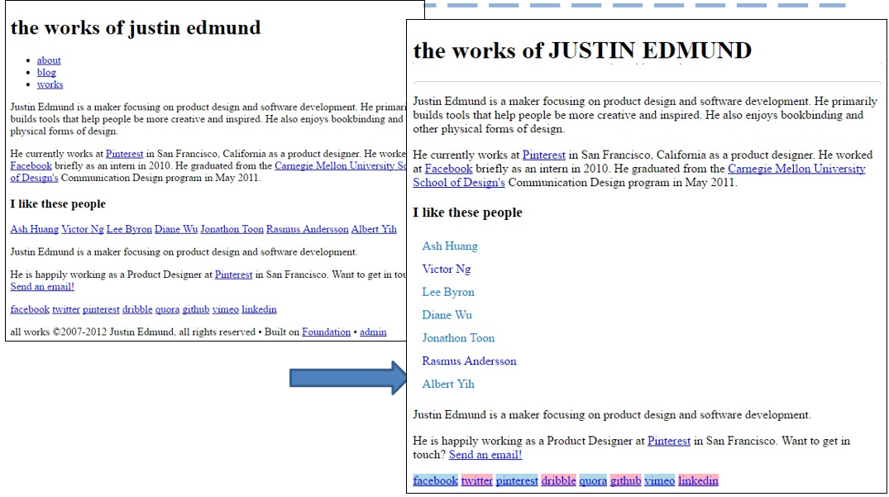
Exercise 2c

Slide 29
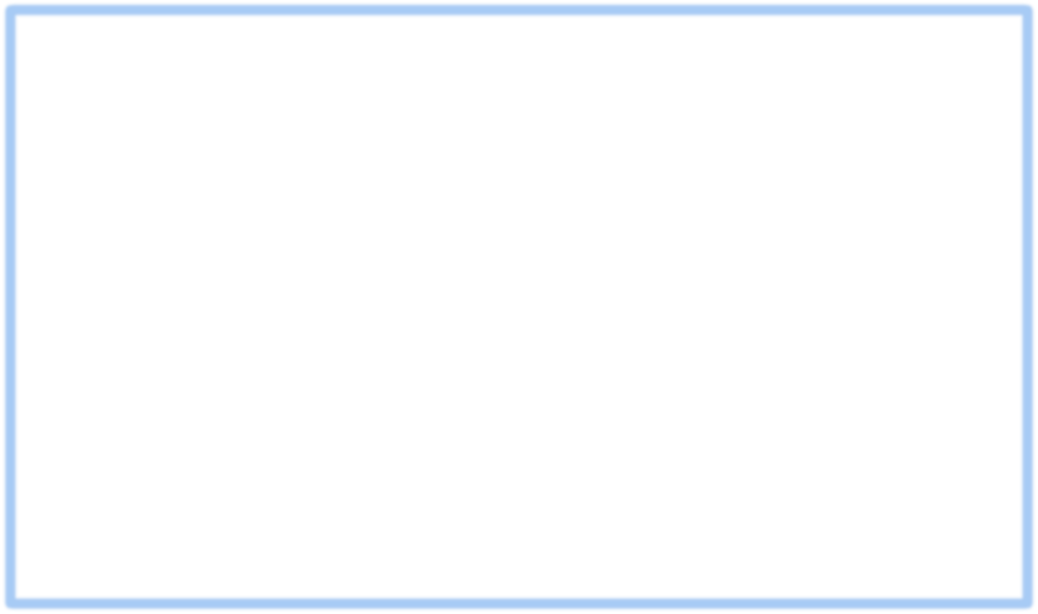
Exercise 2c - solution
$(".back").css("text-transform", "uppercase");
$("ul").addClass("top");
$("ul li").css("display", "inline");
$("#friends a[href$='.com/']").css("color", "#0087cc");
$("#friends a").addClass("nav");
$("#social a:even").css("background-color", "lightblue");
$("#social a:odd").css("background-color", "lightpink");
$("p:last").css("font-size", "8px");

Slide 30
jQuery Best Practices
Implement a fallback to your locally hosted library of same version
<script type="text/javascript" src="//ajax.googleapis.com/ajax/libs/jquery/2.1.1/jquery.min.js"></script>
<script>window.jQuery || document.write('<script src="js/jquery-2.1.1.min.js" type="text/javascript"><\/script>')
</script>
DO NOT use jQuery version 2.x if you support Internet Explorer 6/7/8.
For new web-apps with no plugin compatibility issue, use the latest jQuery version.
When loading jQuery from CDN's, always specify the complete version number you want to load (Example: 1.11.0 as opposed to 1.11 or just 1).
DO NOT load multiple jQuery versions.
IMPORTANT: Links to CSS stylesheets (whether external or internal) must be placed BEFORE Any Javascript programming, including jQuery.

Slide 31
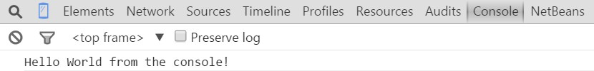
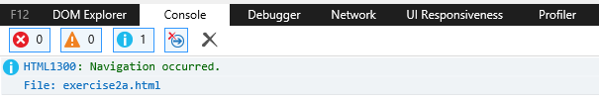
Debugging jQuery/JavaScript errors
In Chrome browser. Do a Ctrl-Shift-J to open up the Javascript Console (Chrome Menu: More Tools > Javascript Console)
In IE browser, right-click the page and select “Inspect”. Go to Console to see errors

Slide 32
What you learnt today
Demonstrate understanding of Document Object Model (DOM) manipulation to HTML and CSS
Download JQuery library and apply to webpages
Apply JQuery selectors and action methods to modify HTML elements
Perform function on document.ready()
Debug Javascript code using console.log

